Slide 1
Hall of Fame: Do the best really get in?
Abe Stephenson, Jacob Schwenneker, Jeremy Miranda, Mason Ohnemus

Slide 2
Index
Project Background and Purpose - Abe Stephenson
Introduction to Dataset - Abe Stephenson
Standardized Measurement - Mason Ohnemus
Comparison of Approximate Value per Position - Mason Ohnemus
538 Data - Jeremy Miranda, Jacob Schwenneker
Conclusion - Jacob Schwenneker

Slide 3
Project Background and Purpose - Abe Stephenson
Background:
A player must perform exceptionally well in order to be inducted
Wide Receivers tend to get into the hall of fame more often, which some find unfair
There is no standardized measure for hall of fame worthiness
Purpose:
Is there a normalized statistic that we can set as a benchmark?
Are Wide Receivers actually deserving of being inducted at a higher rate?
Are other players/positions with similar statistics getting in just as often?

Slide 4
Introduction to Dataset(s) - Abe Stephenson
Datasets used:
FiveThirtyEight
nflwr_history
Career receiving statistics
ProFootballReference
Hall of Fame
Inducted into the Hall of Fame
ProFootballReference
Player Season Finder Query
Approximate Value
Data Manipulation used:
Joining
Mutating
Filtering
Selecting
Graphing/visualization

Slide 5
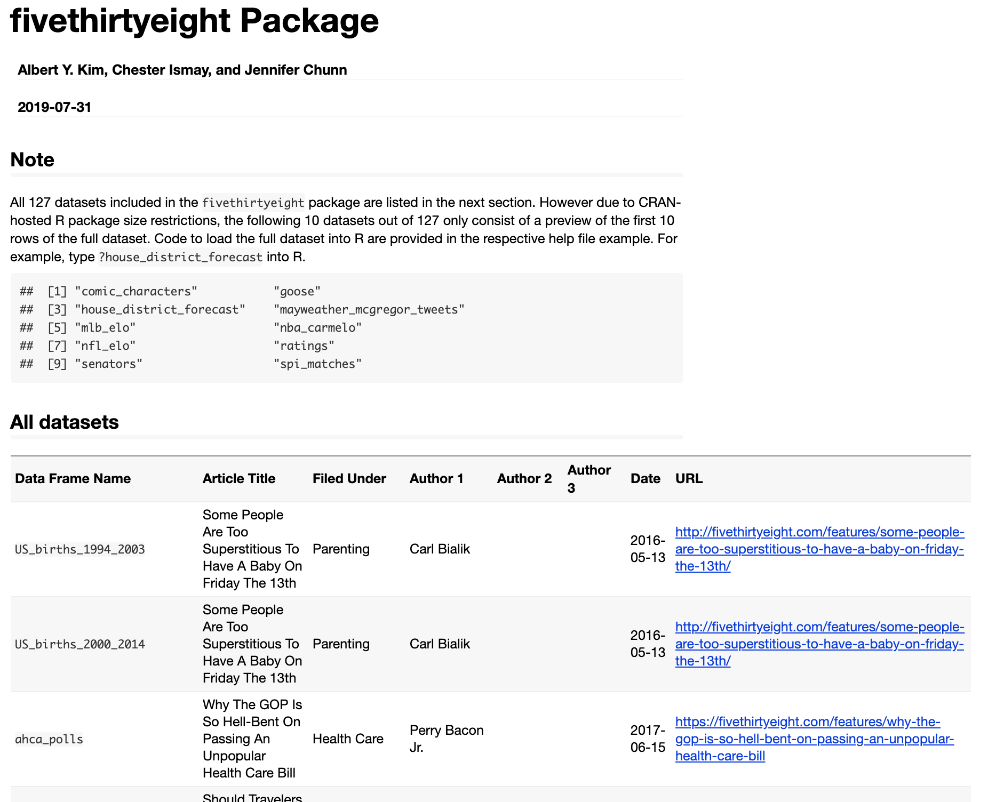
Five Thirty Eight - Abe

Slide 6
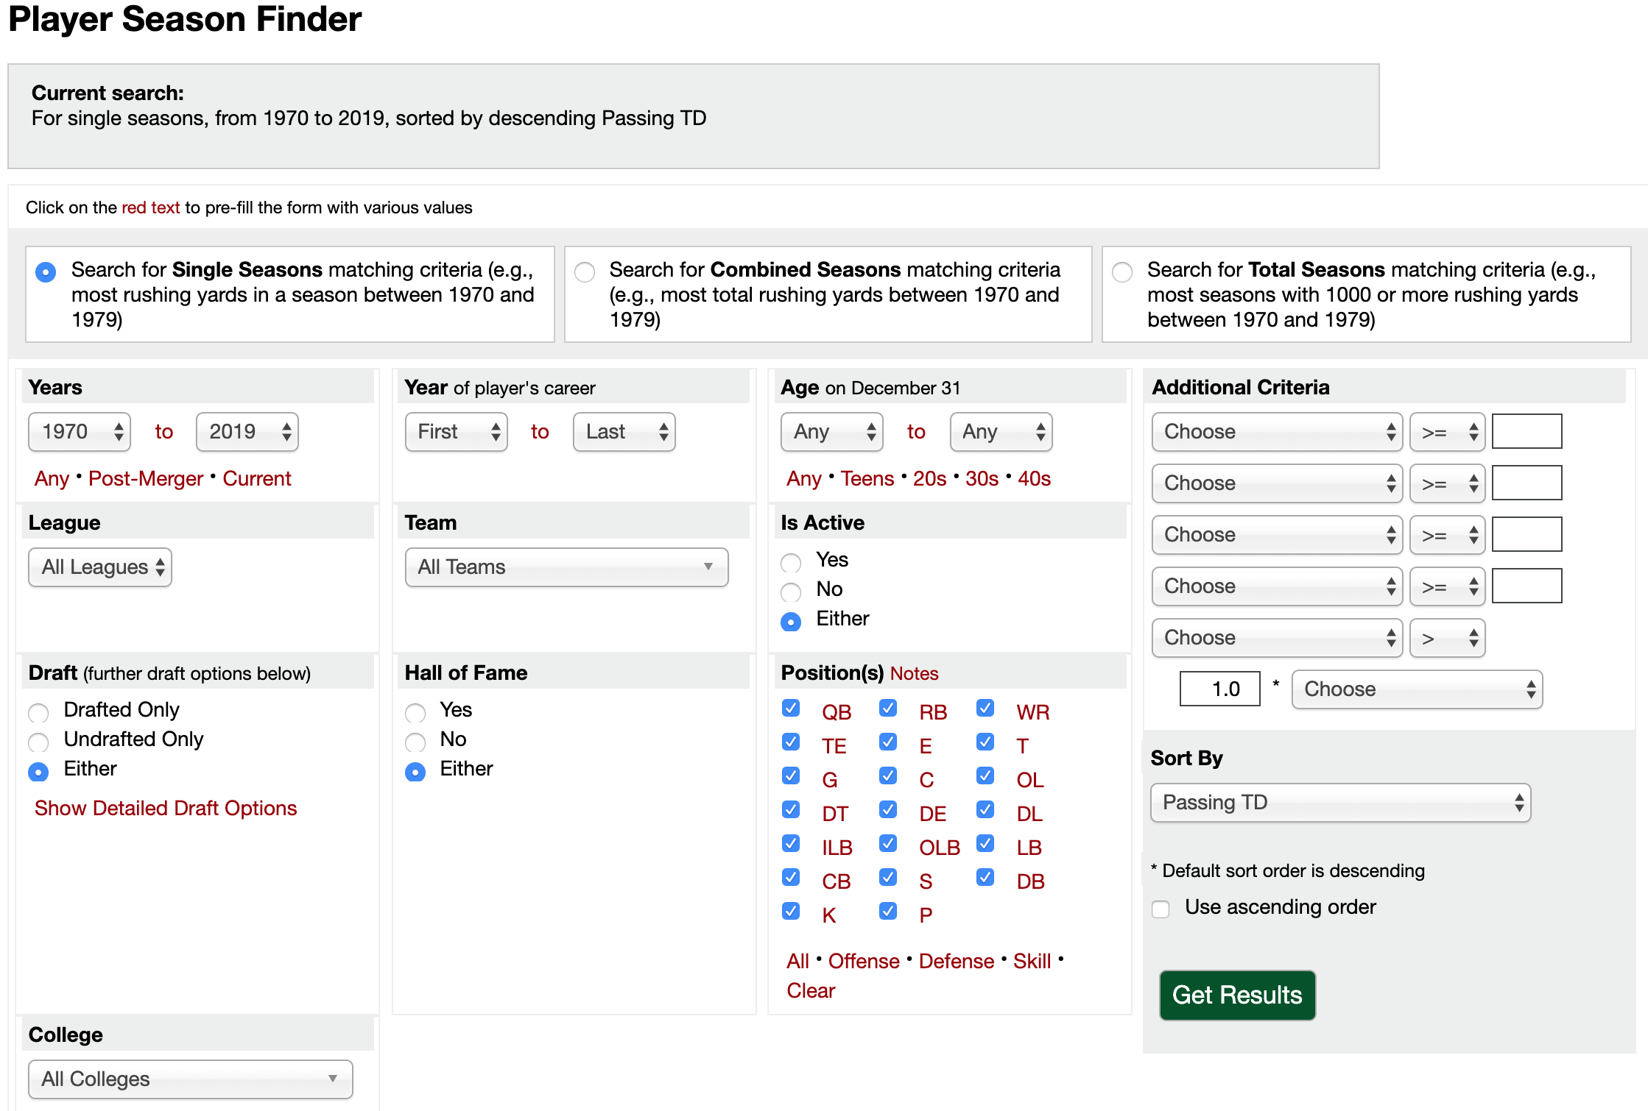
Pro Football Reference - Abe

Slide 7
Introduction to Dataset(s) - Abe Stephenson
Datasets used:
FiveThirtyEight
nflwr_history
Career receiving statistics
ProFootballReference
Hall of Fame
Inducted into the Hall of Fame
ProFootballReference
Player Season Finder Query
Approximate Value
Data Manipulation used:
Joining
Mutating
Filtering
Selecting
Graphing/visualization

Slide 8
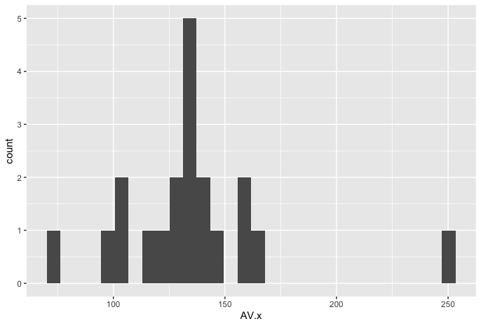
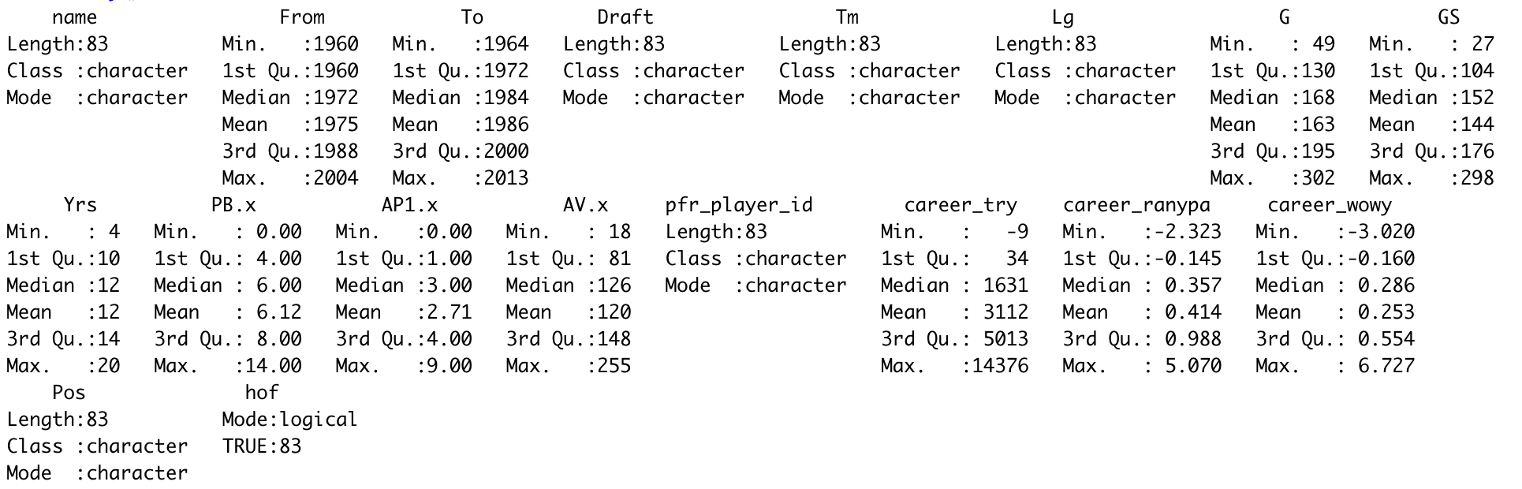
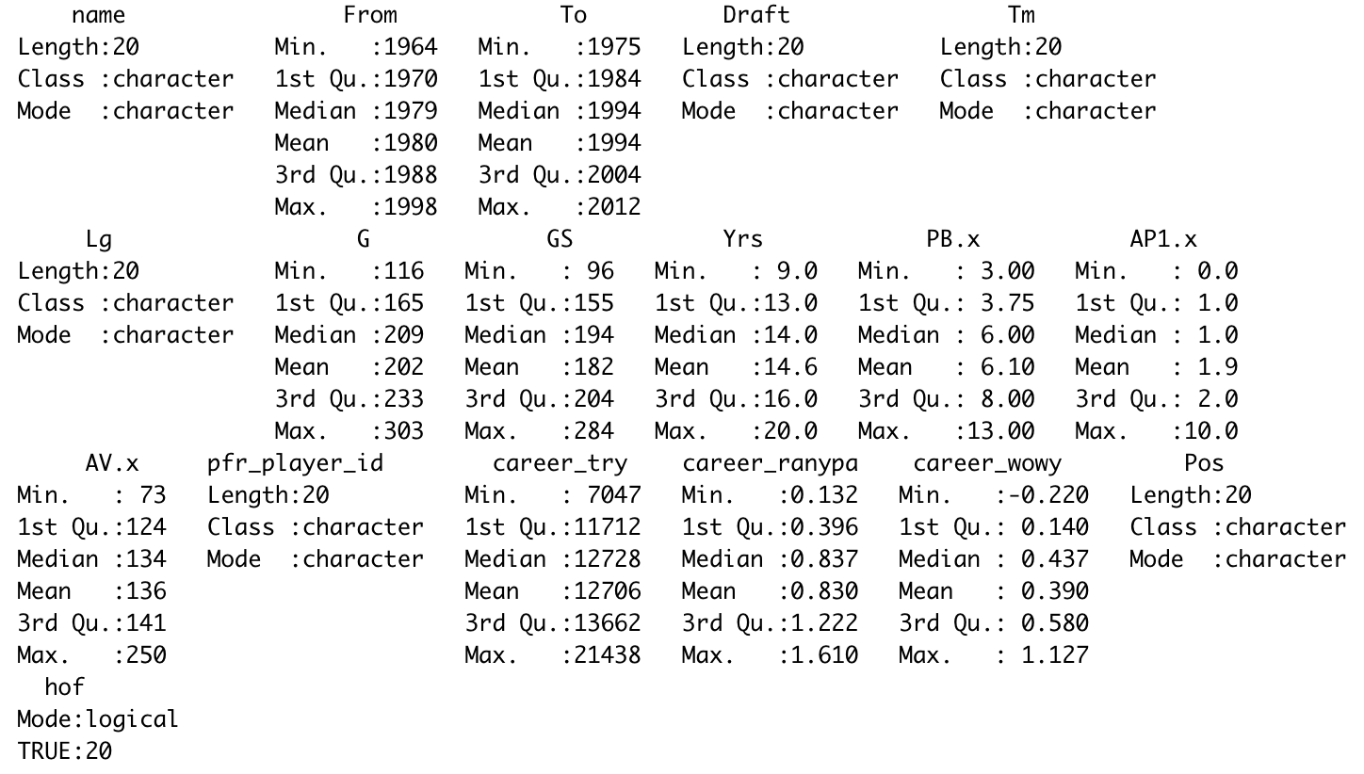
Standardized Measurement - Mason Ohnemus
Approximate Value: Statistic developed by
Pro-Football-Reference to put a single-number valuation on each player season to be comparable across positions
Computed by: 100% of the player's best season, plus 95% of his 2nd-best season, plus 90% of his 3rd-best season, plus 85% of his 4th-best season
Non-WR Hall of Fame AV
WR Hall of Fame AV
Notes:
One of the biggest challenges that comes with comparing football players is how to get them “apples to apples”. Each position performs a very different duty that makes some of their statistics look very impressive, while other statistics look very poor. Such as a wide receiver, they typically have countless yards, but will likely never have any sacks like a Linebacker would. So how do you compare the two? One of our datasets, Pro football reference, solved this issue. They found a way to get players to apples to apples by developing a statistic called their Approximate Value. This statistic allowed for all positions to be compared over all years. They compute this by establishing a value to all key areas of each position, as well as how many starts, pro bowl appearances, and more. They then take a weight from each of their best seasons, and arrive at a final number that is the player’s “value”. You can see more about how this is computed in the slide We used this statistic as our primary way to analyze this issue.
This slide simply brought fourth some simple analysis of this variable. The two tables at the bottom compared the summary of AV’s between non- wide receiver Hall of Fame inductees, and wide receiver inductees. As you can see, the average for Wide Receivers appears to be higher at this point, which is what we were looking for; some way to explain why there are so many in the Hall of Fame. can be a hint that they do deserve the higher percentage of HOF inductions, but we will explore that more on the next slide. The other graph is shows the distribution of AV values, which takes the shape of a bell curve
Now, Let’s take a little closer look at this AV measurement.

Slide 9
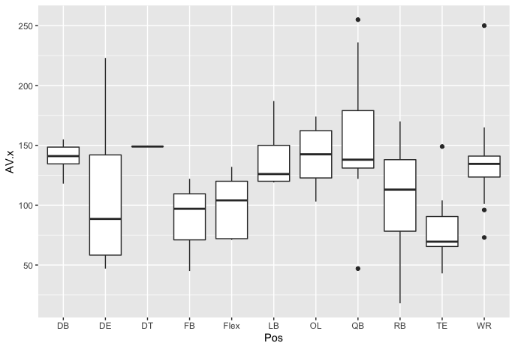
Comparison of AV per Position - Mason Ohnemus
Surprisingly, WR does not possess the highest AV.
Based off of this observation alone, wide receivers do not possess a higher “value” that could contribute to their higher Hall of Fame Induction rates
Notes:
In this slide, we expand more on the Approximate Value statistic. As mentioned in the last slide, on average the Wide Receivers did have a higher AV compared to non-wide receiver inductees. That statistic is useful for comparing one group to all of the rest, but would it not be useful to look at all of the positions next to each other? This graphic shows how each position compares in regards to AV. As you can see, Wide Receivers are not at the top.It appears to be passed by quarterbacks, offensive line, and possibly defensive backs. Based on this analysis, we see a slight indication that these positions do deserve to be in the hall of fame more often, as they are valued higher than others. While this statistic was extremely useful in explaining the hall of fame trends, we found it would be fitting to dig further into the data though, as you will see in the next slides.

Slide 10
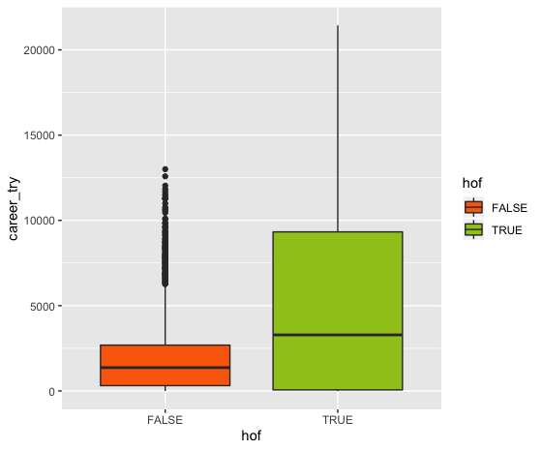
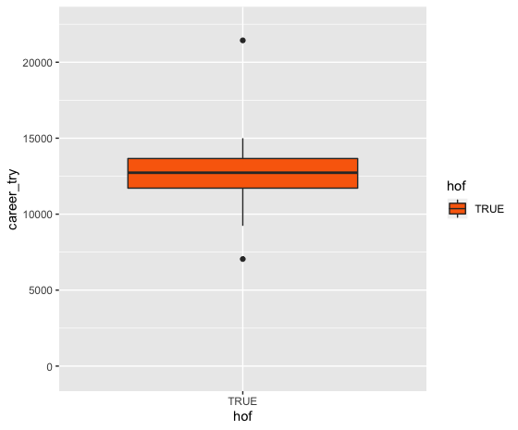
538 Data: Career TRY - Jeremy Miranda
All Players Wide Receivers
True Receiving Yards (TRY): A measurement of career true receiving yards

Slide 11
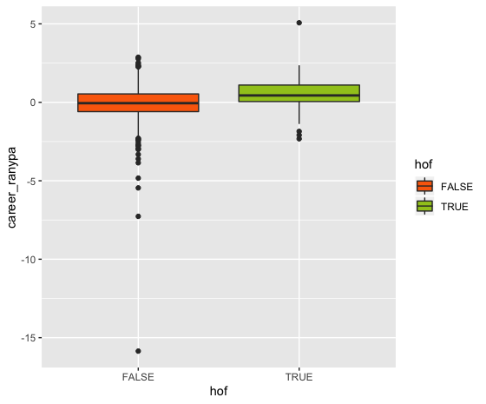
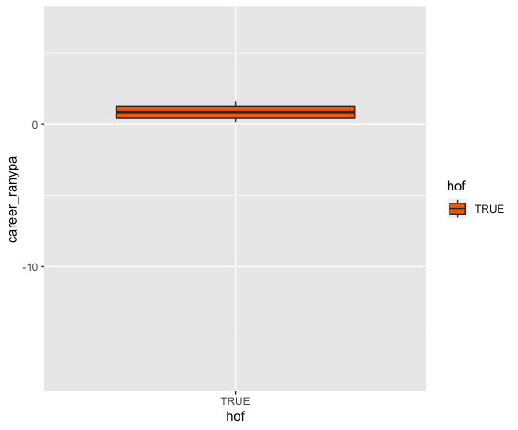
538 Data: Career RANYPA - Jeremy Miranda
All Players Wide Receivers
Receiving Adjusted Net Yards Per Attempt (RANYPA): A measurement of adjusted net yards per attempt (relative to average) of player’s career teams, weighted by TRY w/ each team

Slide 12
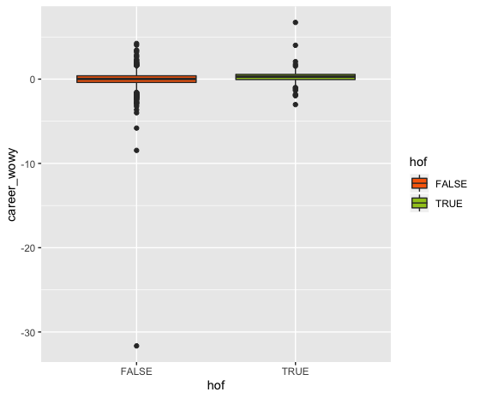
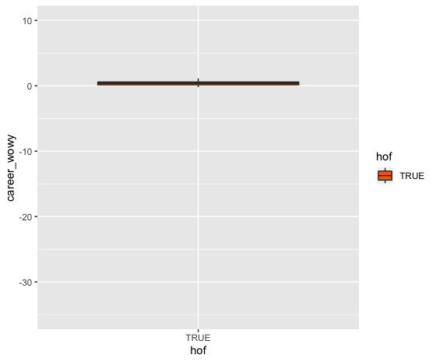
538 Data: Career WOWY - Jacob Schwenneker
All Players Wide Receivers
With or Without You (WOWY): A measurement of the amount by which career_ranypa exceeds what would be expected from his QBs’ (age-adjusted) performance without the receiver

Slide 13
Conclusion - Jacob Schwenneker
Based off of our findings..
Having a quality data set is of the utmost concern
A good statistic to measure a player’s Hall of Fame worthiness is an Approximate Value number, which then allows all players to be compared
Both Quarterbacks and Wide Receivers have the raw statistics to back their higher Hall of Fame Induction rates, but efficiency and other advanced statistical outlooks are not so positive
AV measurements support this
Players in other positions who possess similar, or better, statistics relative to wide receivers are less likely to be inducted into the Hall of Fame

